Slide 1
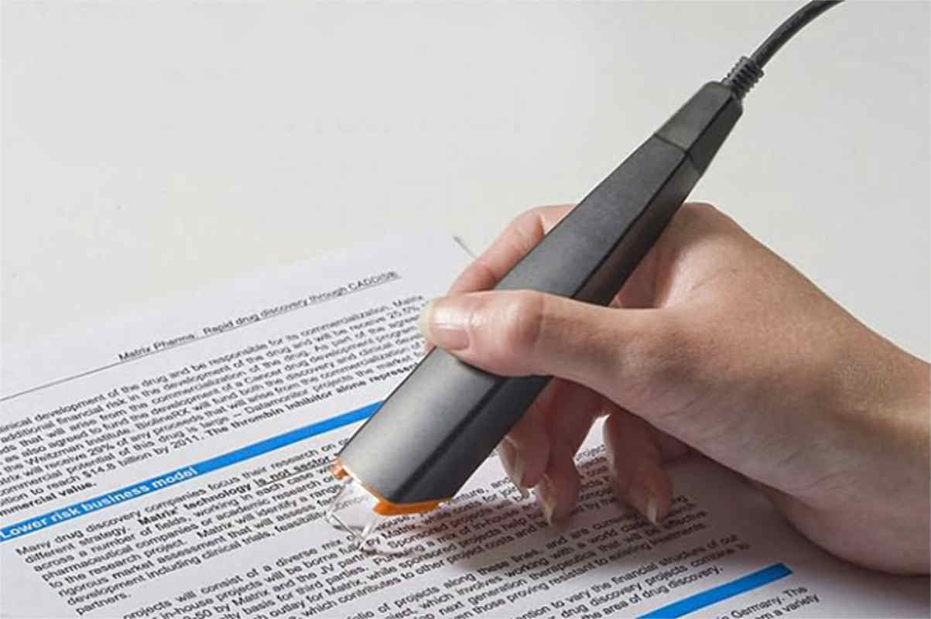
OpticalCharacter Recognition

Slide 2

INTRODUCTION
What is OCR?
ArtificialNeuralNetworks
Objectives

Slide 3
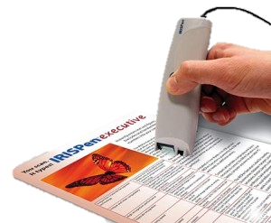
Introduction
What is OCR?
Optical Character Recognition
Process of extracting text from images.
Common method of digitizing printed texts.
OCR is a field of research in pattern recognition, artificial intelligence and computer vision.

Slide 4
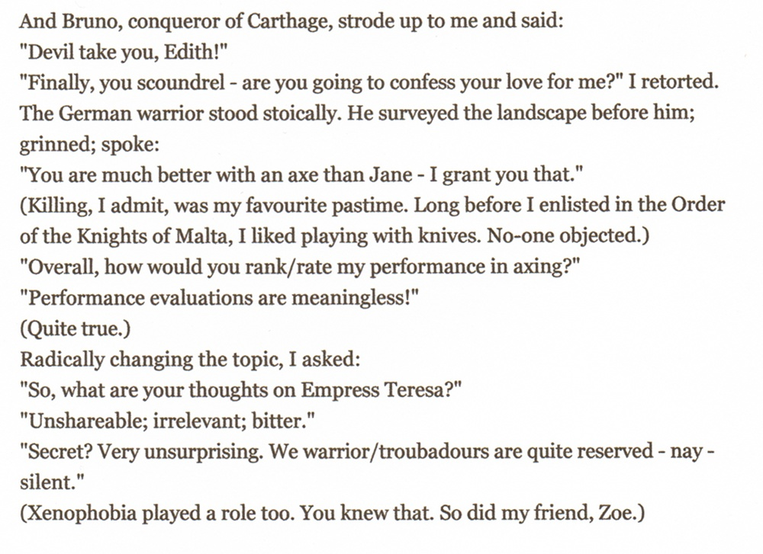
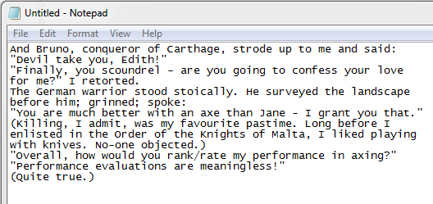
Introduction
What is OCR?
Picture with text -> editable text
Fig: Image with text
Fig: Recognised text in editor

Slide 5
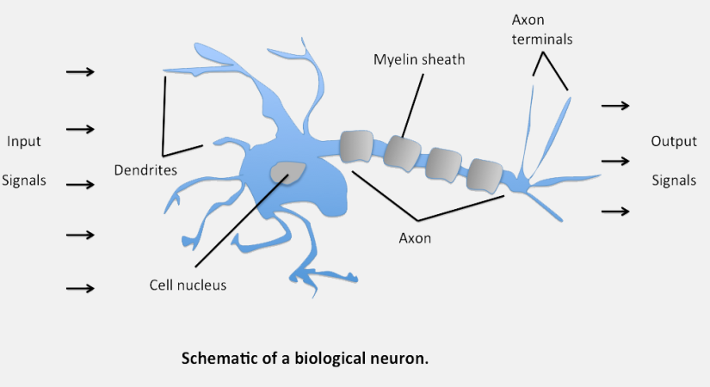
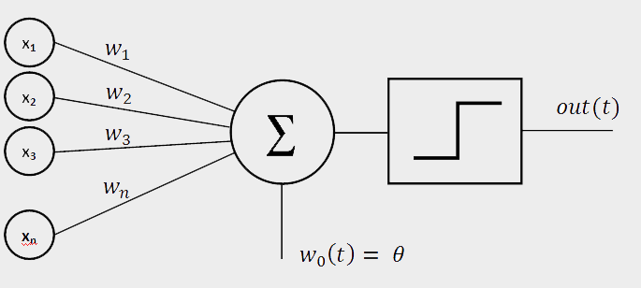
Introduction
Artificial Neural Network
Inspired by biological neural network
Functional unit is neuron.
Neuron takes several inputs and produces single output.
Needs to be trained first with set of examples called training data.
Training sets values for weights and biases.
Increase no. of training examples - improve its accuracy.
Fig: model of a perceptron
Notes:
- Neuron may be perceptron, sigmoid neuron, etc.

Slide 6

Introduction
Objectives
Accurate text recognition
To create an OCR software that recognizes characters from a scanned image of printed text.

Slide 7

ANALYSIS
Functional Requirements
Non - Functional Requirements

Slide 8
Analysis
Functional Requirement
Input valid image.
Crop image.
Process image.
Detect characters.
Recognize and display characters.
Notes:
Process the input given by the user only if it is an image file (JPG, PNG, etc.)
The system will detect the characters present in the image.
The system will recognize the characters and display them to the user.

Slide 9

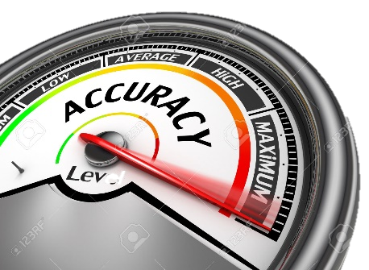

Analysis
Non-Functional Requirement
Performance
Reliability
Flexibility
Extensibility
Notes:
Performance – Quick processing and fast recognition.
Reliability – Accurate recognition(more than 90%)
Flexibility – accepts images in standard formats like JPEG, PNG, BMP.
Extensibility – Can add additional features to increase versatility.

Slide 10

DESCRIPTION
System Diagram
Methodology

Slide 11
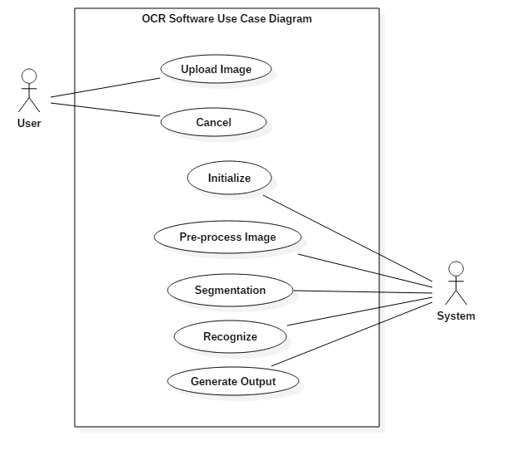
Description
Use Case Diagram
Fig: Use Case Diagram

Slide 12
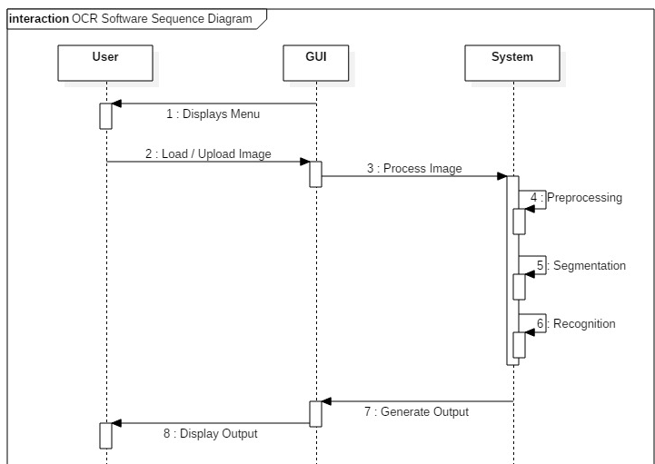
Description
Sequence Diagram
Fig: Sequence Diagram

Slide 13
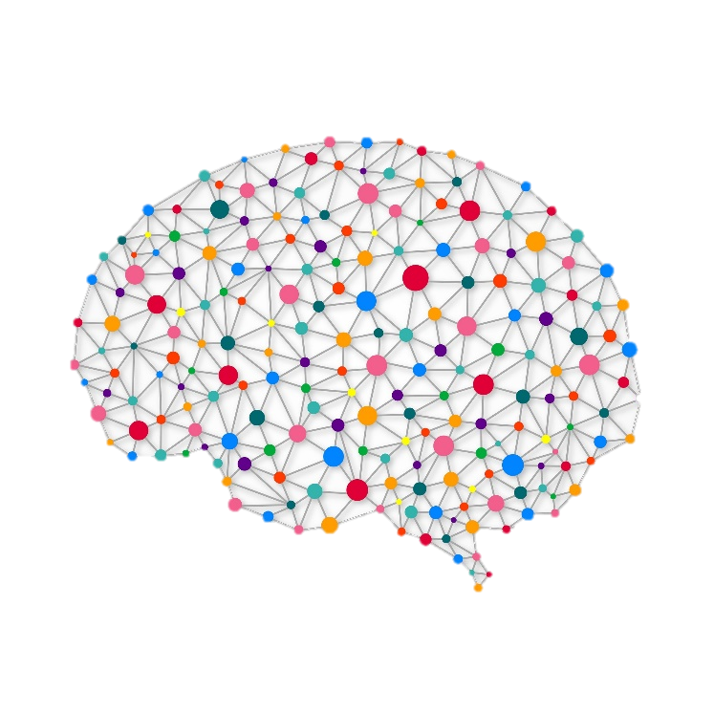



Description
Methodology
Prototype software development model
Neural network for pattern recognition
Python Programming Language 2.7
Python Libraries used:
Numpy
Scipy
openCV
Scikit-learn
Pillow (PIL)
PyQt
PyGame
Py2exe
Notes:
NEURAL NETWORK
PYTHON BECAUSE LIBRARY AND DATA HANDLING
NUMPY, OPENCV

Slide 14
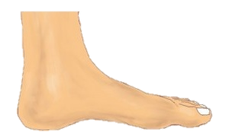
Description
Methodology
OCR Process
Notes:
PROCESS MAINLY CONSISTS OF TWO PARTS
NEURAL NETWORK
IMAGE PROCESSING

Slide 15
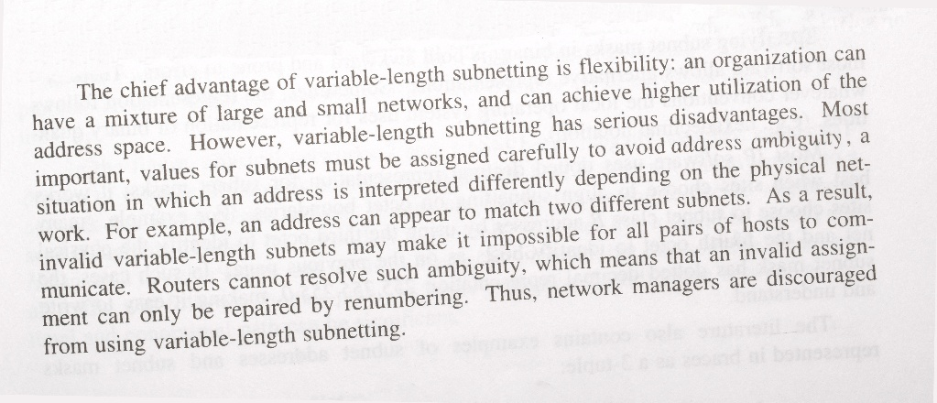
Description / Methodology
Image Processing
1. Image acquisition
Retrieve image saved in a remote location in the computer.
Image formats supported are:
JPG, PNG, GIF
Image is imported as greyscale image.
Fig: Original Image
Notes:
RETRIEVE IMAGE
SUPPORTED FORMATS: JPG, PNG, GIF

Slide 16
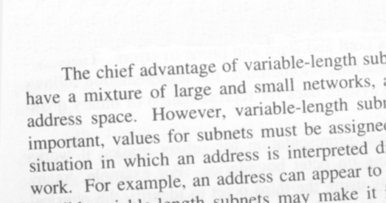
Description / Methodology
Image Processing
2. Noise Removal
Use blur/smoothen.
Gaussian blur
Fig: Original Image
Fig: Blurred Image
Notes:
NOISE IS REMOVED
USING GAUSSIAN BLUR

Slide 17
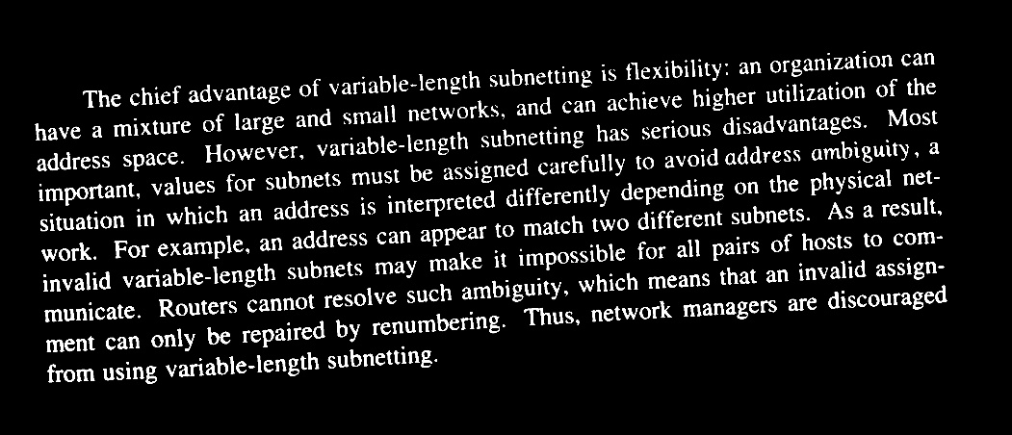
Description / Methodology
Image Processing
3. Normalization
Binary normalization
Convert image pixels to one of two pixels – either black or white.
Uses threshold() function.
Otsu binarization
Invert image color
Fig: Binarized Image
Notes:
OTSU BINARIZATION
USING THRESHOLD AND INVERT

Slide 18
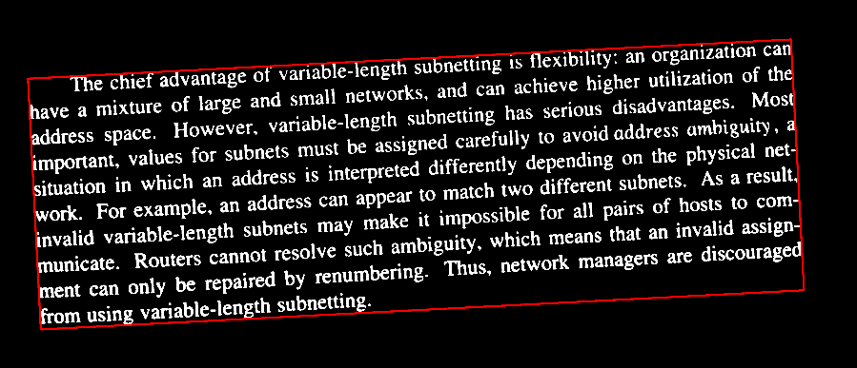
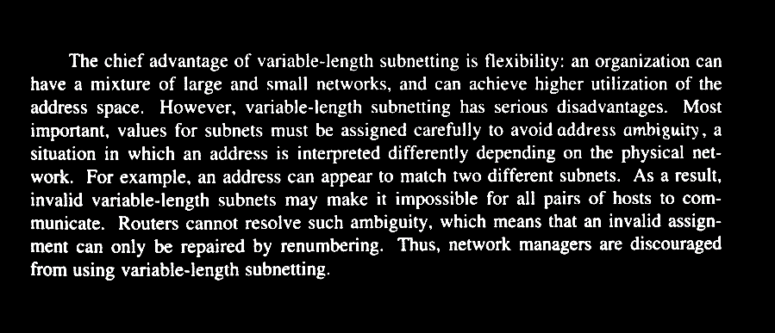
Description / Methodology
Image Processing
4. Tilt Detection
Detect text pixels.
Create minimum area enclosing the pixels.
Calculate tilt angle.
Perform necessary rotation to straighten the image.
Fig: Detecting Tilt
Fig: Correcting Tilt
Notes:
IMAGE IS ROTATED BY DETECTED TILT ANGLE

Slide 19
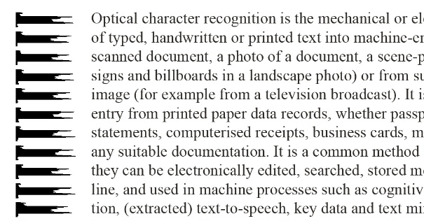
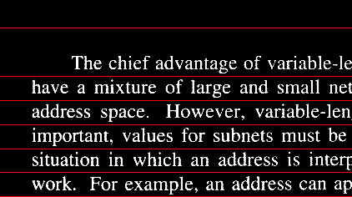
Description / Methodology
Image Processing
5. Line Detection
Calculate horizontal projections of the image.
Based on threshold value, separate out each line from the image.
Fig: Horizontal Projections
Fig: Detecting Lines
Notes:
USING HORZONTAL PROJECTIONS OF THE IMAGE
DETECT GAPS AND SEPARATE OUT LINES

Slide 20
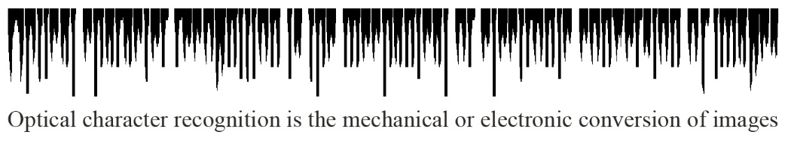
Description / Methodology
Image Processing
6. Word Detection
Calculate vertical projections of the image.
Based on threshold value, separate out each word from the line image.
Fig: Vertical Projection
Fig: Word Segmentation
Notes:
USING VERTICAL PROJECTIONS OF THE IMAGE

Slide 21










Description / Methodology
Image Processing
7. Character Detection
Fig: Contour Detection
Find contours.
Create separate character images based on contours.
Resize to 32 x 32 image with added padding.
Fig: Draw boundary from contour
Fig: Final extracted and resized characters
Fig: Detect character using boundary coordinates
Notes:
FIND CONTOUR
SEPARATE OUT THE INDIVIDUAL CHARACTERS

Slide 22
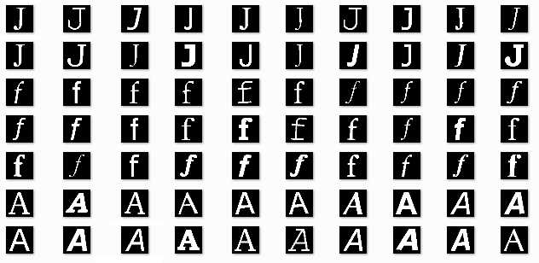
Description / Methodology
Neural Network
1. Create training dataset
Character set:
0 – 9 : 0 – 9
a – z : 10 – 35
A – Z : 36 – 61
. , - ? : 62,63,64,65
400 sample images for each character (32 x 32)
Fig: Training data set

Slide 23
Description / Methodology
Neural Network
1. Create training dataset
10 fonts:
Arial, Bookman Old Style, Calibri, Courier, Garamond, Helvetica, Optima, Palatino, Times New Roman, Verdana
4 styles:
Regular, Bold, Italics, Bold Italics
Total samples : 264,000
Fig: Training data set

Slide 24
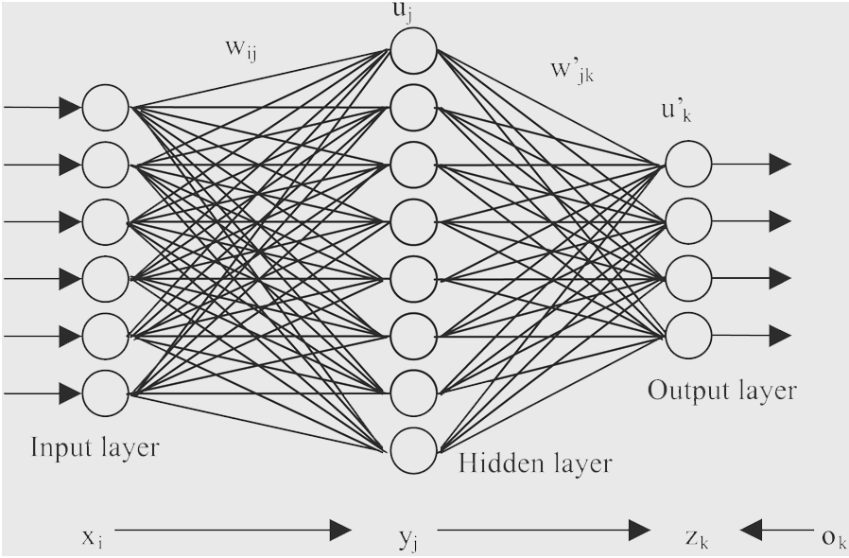
Description / Methodology
Neural Network
2. Neural Network Design
Three layers:
Input layer – 1024 neurons
Hidden layer – 30 neurons
Output layer – 66 neurons
Fig: NN Architecture

Slide 25
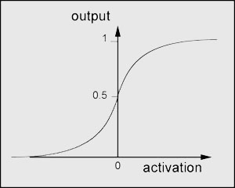
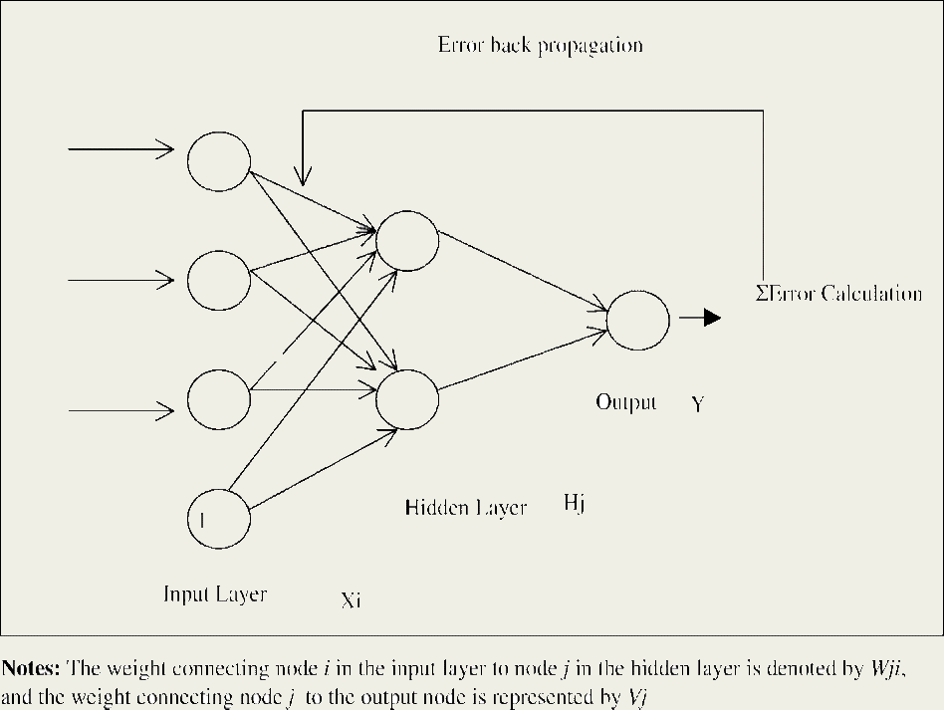
Description / Methodology
Neural Network
3. Training the Neural Network
Fig: sigmoid function
Sigmoid neuron
Stochastic gradient descent learning algorithm
Back propagation
Regularization
Cross-entropy cost function
Fig: error back-propagation algorithm
Notes:
Regularization – FIXES OVERFITTING, MAKE THE NETWORK PREFER TO LEARN SMALL WEIGHTS. LARGE WEIGHTS ONLY IF PERFORMANCE IS CONSIDERABLY IMPROVED.

Slide 26
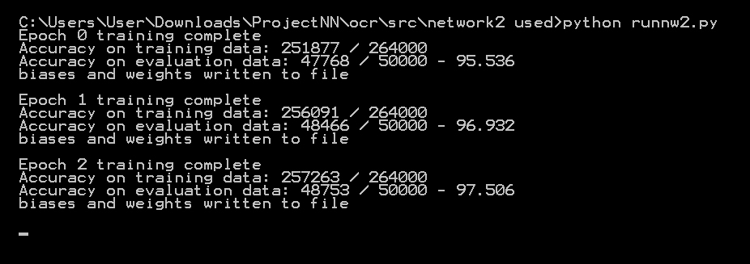
Description / Methodology
Neural Network
3. Training the Neural Network
Fig: neural network training

Slide 27
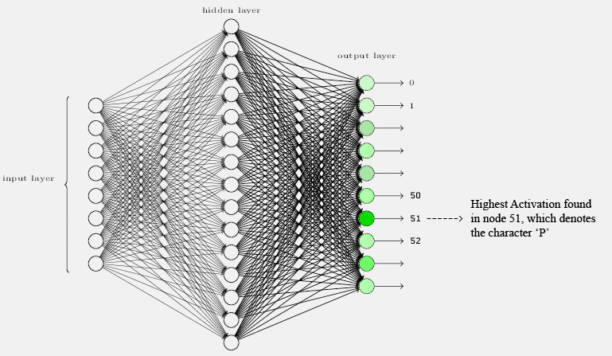
Description / Methodology
Neural Network
4. Text Recognition
Neural Network’s output is assumed to be the index of the activated neuron in output layer.

Slide 28
IMPLEMENTATION
Problems faced
Graphical User Interface

Slide 29


Implementation
Problems faced
“i” and “j” segmentation problem
Since “i” and “j” contain separate superscript dot, the segmentation algorithm would recognize the dot as separate segment.
Solution – compare separation height with a threshold to check if the dot is a superscript dot or a fullstop. Make sure by comparing x- coordinate as well.
Fig: Two separate contours in “i”
Fig: result after solution

Slide 30


Implementation
Problems faced
“.” and “,” segmentation problem
Segmented image would contain a big symbol – unusable for recognition.
Solution – compare height with a threshold to determine the image is a fullstop or a comma. Increase the height of the bounded rectangle by increasing padding.
Fig: large comma problem
Fig: result after solution

Slide 31
Implementation
Optimization
Uppercase | Lowercase
C | c
O | o
S | s
V | v
W | w
X | x
Z | z
Uppercase and lowercase confusion
Similar looking uppercase and lowercase characters are misinterpreted as each other.
Solution – Use only the lowercase letters in such cases.
Fig: confusion class

Slide 32

Implementation
Optimization
Dictionary Use
Each recognized word is sent to correction function (without special characters).
The function returns:
The original word, if it is present in the dictionary;
The list of known words at one edit distance away, if there are any;
The list of known words at two edit distance away, if there are any;
The original word, even though it is not in the dictionary.

Slide 33
Implementation
Optimization
Dictionary Use
Estimate probability of each word.
Choose the candidate with highest probability.
Fig: confusion class
Notes:
The probability of a word is estimated by counting the number of times each word appears in the dictionary file.

Slide 34
Implementation
Input character
Optimization
Classification Engine 1
Output
Two Stage Classification
Is output in confusion class?
For conflicts between similar looking characters.
The second processing stage becomes active for the decision on the difficult cases .
No
To file
Yes
Classification Engine 2
Fig: Two stage classification flowchart
Notes:
The probability of a word is estimated by counting the number of times each word appears in the dictionary file.

Slide 35
Implementation
Optimization
S/no. | Confused Classes
1 | i,j,1,l,I
2 | c, e, G
3 | K, k
4 | M, m
5 | U, u
6 | P, p
7 | Y, y
8 | A, R
9 | T, t
10 | B, 8
11 | b, h
12 | v, y
13 | t,l,1,L
2 Stage Classification
For conflicts between similar looking characters.
The second processing stage becomes active for the decision on the difficult cases .
Table: Confusion Classes
Notes:
The probability of a word is estimated by counting the number of times each word appears in the dictionary file.

Slide 36
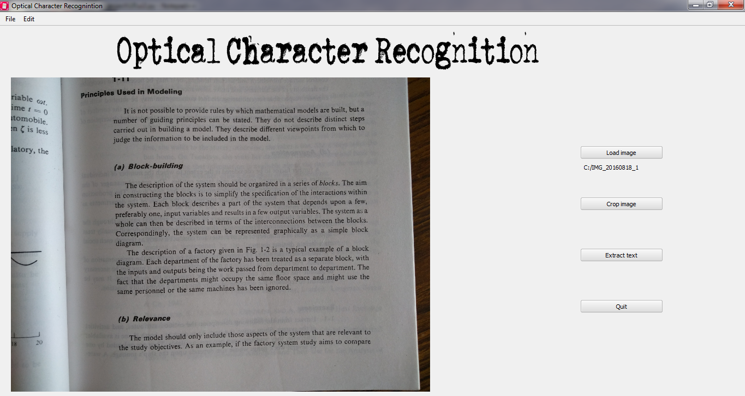
Test Results
Graphical User Interface
Fig: Program GUI

Slide 37
TEST RESULTS
EpochCountvs accuracy
Test Run

Slide 38
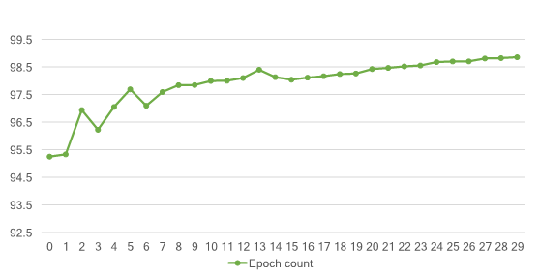
Test Results
Epoch count vs. accuracy (training data)
98.854
Accuracy
Learning rate = 0.5
No of epochs = 30
Mini batch size = 10

Slide 39
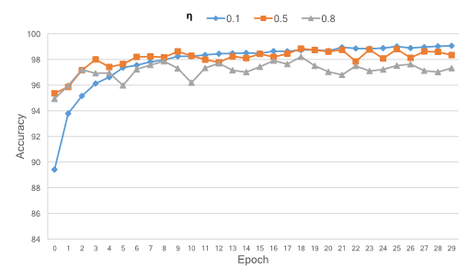
Test Results
Epoch count vs. accuracy (for varying learning rates)
No of epochs = 30
Mini batch size = 10

Slide 40
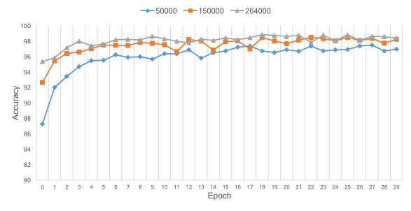
Test Results
Epoch count vs. accuracy (for varying training data)
Learning rate = 0.5
No of epochs = 30
Mini batch size = 10

Slide 41
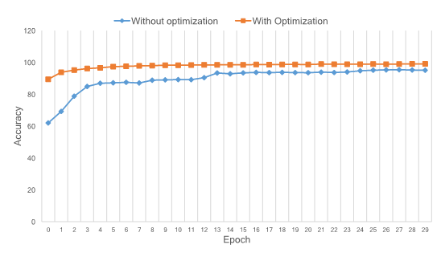
Test Results
Epoch count vs. accuracy
(use of regularization and cross-entropy cost function)
Learning rate = 0.5
No of epochs = 30
Mini batch size = 10

Slide 42
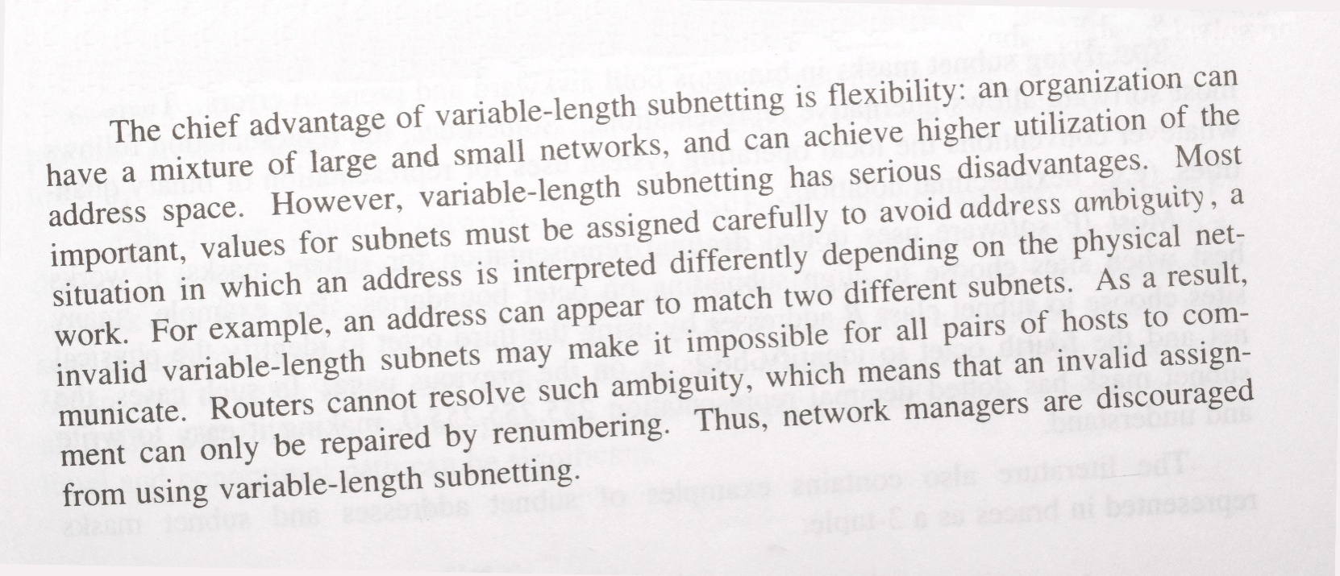
Test Results
Test Run
Fig: Input Image

Slide 43
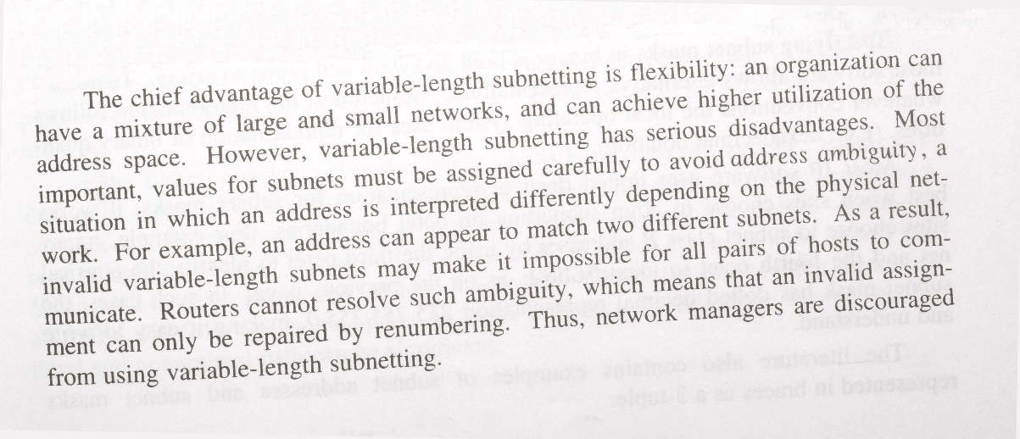
Test Results
Test Run
Fig: Input Image
The chief advantage of variable.length subnetting is QeNibility an organizati9n can
have a mixture of large and small networks, and can achieve higher utilization of the
address space. However, variable-length subnetting has serious disadvantages. Most
imponant, values for subnets must be assigned carefully to avoid address ambiguip 1 a
situation in which an address is intemreted differently depending on the physical net.
work. For example, an address can appear to match two different subnets. As a result,
invalid vadable.length subnets may make it impossible for all pairs of hosts to com-
municate. Routers cannot resolve such ambiguity, which means that an invalid assign.
ment can only be repaired by renumbering. Thus, network managew are discouraged
from using variable.length subnetting.
Fig: Extracted text

Slide 44
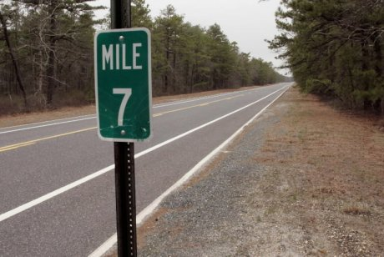
Implementation
Limitations
Text separation.
The system cannot work with an input image consisting of only a small amount of text and a large amount of scenery.
The text should be darker and the background should be brighter.
Fig: text with background scenery
Notes:
This issue is somewhat minimized by cropping function.
(preferably white).

Slide 45
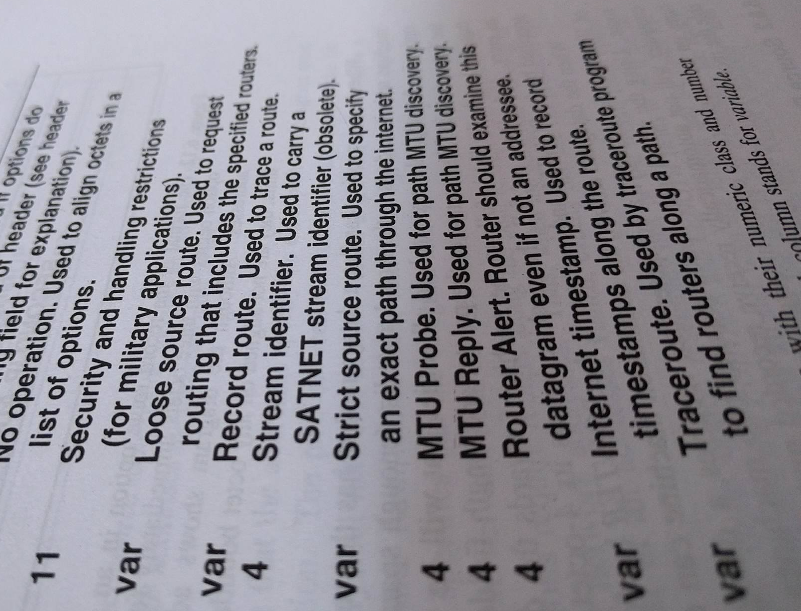
Implementation
Limitations
Skewed text.
The text lines in the input image should be prominently separated such that it is possible for detection by horizontal projection method.
Fig: skewed text

Slide 46

Implementation
Future works
There is always room for improvement.
Addition of skew correction.
More interactive GUI.
Handwriting recognition
Processing using CUDA
Notes:
a framework for GPU utilization during processing.

Slide 47
THANK YOU!

